Slide 1
UNIT III Planning
The task of coming up with a sequence of actions that will achieve a goal is called planning
classical planning environments
fully observable, deterministic,finite, static (change happens only when the agent acts), and discrete (in time, action, objects,
and effects). These are called. In contrast,
Nonclassical planning
is for partially observable or stochastic environments and involves a different set of algorithms and agent designs

Slide 2
THE PLANNING PROBLEM
Agent Environment STATES are represented as valuations of state variables.
An action can be represented as a procedure or a program.
The procedures are used to compute values of state variables.
After the execution of procedure (i.e after the action),the environment state will be changed, towards the goal.

Slide 3
Planning algorithms
representation of planning problems-states, actions, and goals
Algorithms are nothing but logical structure of the problem.
To define an efficient algorithm language is very important.
STRIPS language(Standford Research Institute and Problem Solver).

Slide 4
Representation of States
Planners decompose the world into logical conditions and represent a state as a conjunction of positive literals.
Literals in first-order state descriptions must be ground (single data not variables)and function-free. Literals such as At(x, y) or At(Father(Fred), Sydney) are not allowed.
The closed-world assumption is used, meaning that any conditions that are not mentioned in a state are assumed false.

Slide 5
Representation of goals
. A goal is a partially specified state, represented as a conjunction of positive ground literals
A propositional state s satisfies a goal g if s contains all the atoms(ground literal)in g.
The propositional state Rich^Famous^Happy satisfies the goal state Rich^Famous.

Slide 6
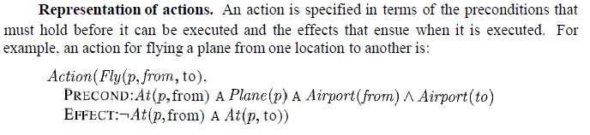
Representation of actions

Slide 7
Action schema
An action schema consists of three parts:
The action name and parameter list-for example, Fly(p, from, to)-serves to identify the action.
The precondition is a conjunction of function-free positive literals stating what must be true in a state before the action can be executed. Any variables in the precondition must also appear in the action's parameter list.
The effect is a conjunction of function-free literals describing how the state changes when the action is executed.

Slide 8
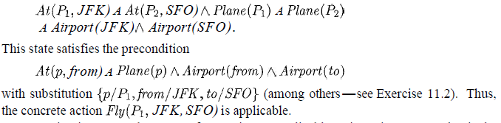
Add list and Delete list
Two categories
Add list-positive literals
Delete list-negative literals
Action is applicable in any state that satisfies the precondition; otherwise, the action has no effect.

Slide 9
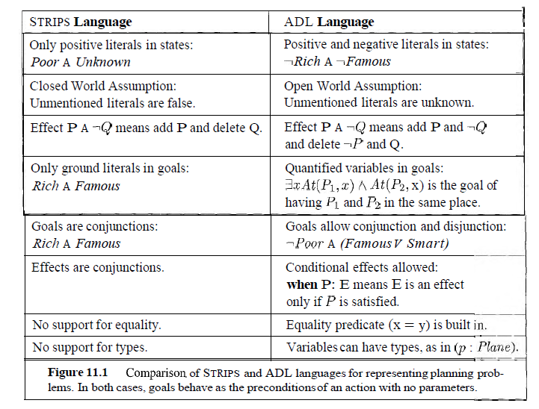

Slide 10
What is STRIPs?
It is a automated planning technique used to find a goal by executing a domain from the initial state of domain.
With STRIPS we can first describe the world(initial state and goal state)by providing objects,actions,preconditions and effects.
To describe the world we used two categories of term
States-initial state and goal state
Action schema-objects ,actions ,preconditions and effects

Slide 11
STRIPS-States,goals,Actions
States: conjunction of ground, function-free and positive literals.
To describe states, closed assumptions is used(the world model contains everything,the agent needs to know.
Goals:conjunction of literals,may contain variables.
Action:precondns that must hold before execution and the effects after exeution.

Slide 12
STRIPS Action Schema
It includes
Action name& parameter list
Precond:a conjunction of function free positive literals.The action variables must also appear in precondition.
Effect:a conjunction of function free literals(positive or negative)
Eg:
Action:But(x)
Preconditon;At(p),Sells(p,x)
Effect:Have(x)

Slide 13
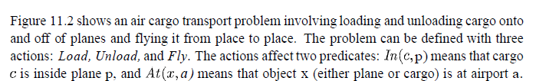

STRIPS - Air cargo transport
Solution

Slide 14
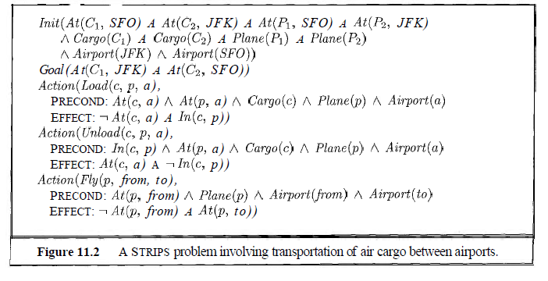

Slide 15
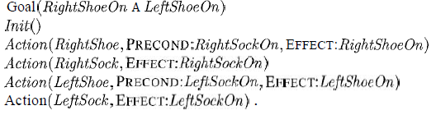
Partial Order Planning-The shoe and sock problem
Works on several subgoals independently
Solves them with subplans
Combines the subplans
Flexibility in ordering the subplans
Least commitment strategy:
delaying a choice during search

Slide 16
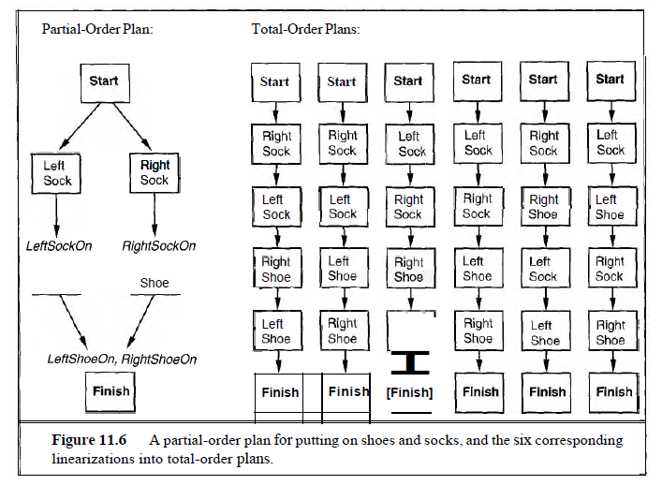

Slide 17
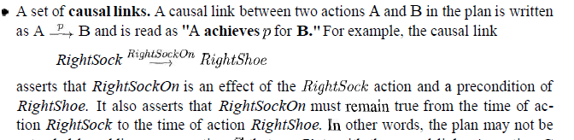
How to define Partial Order plan
A set of actions that make up the steps of the plan.
A set of ordering constraints. Each ordering constraint is of the form A - B, which is read as "A before B" and means that action A must be executed sometime before action B, but not necessarily immediately before.
A set of open preconditions. A precondition is open if it is not achieved by some action in the plan

Slide 18
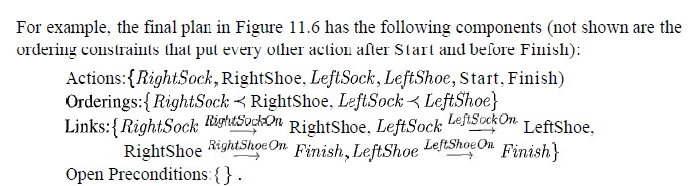
Solultion –shoe problem

Slide 19
POP-Changing a flat tire
Consider the problem of changing a flat tire.
The goal is to have a good spare tire,properly mounted onto the car’s axle
The intial stata a flat tire on the axle and a good spare tire in the trunk.
There are 4 actions
Remove the spare from the trunk
Remove the falt tire from the axle
Putting the spare on the axle
Leaving the car unattended overnight.
We assume that the car is in .particularly bad neighborhood so that the effect of leaving it overnight is that the tire disaapear.

Slide 20
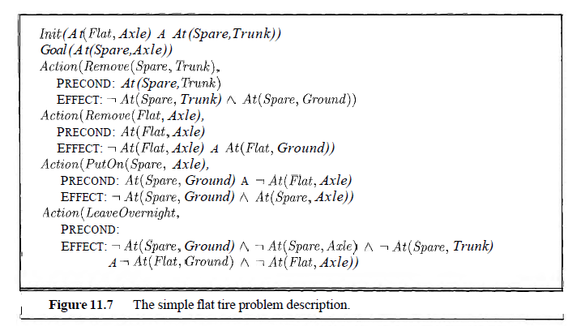
A partial-order planning example

